Slide 1

Task Refactoring
Maximizing Your Personal Throughput
Eric Lynn
DeltaPoint Solutions
@deltapoint

Slide 2





Slide 3


Slide 4


Slide 5

The Key Question

Slide 6


Slide 7


Slide 8


Slide 9

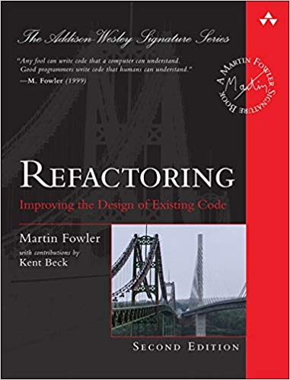
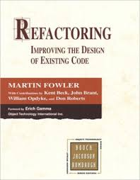
“Any fool can write code that a computer can understand. Good programmers write code that humans can understand.”

Slide 10
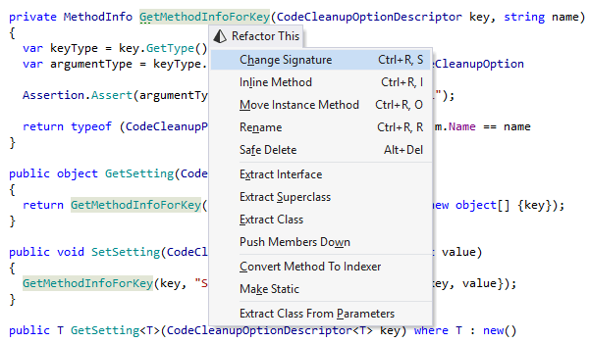

Slide 11
Value of Refactoring
Refactor to understand
Refactor to improve the design
Refactor to allow change to happen smoothly and efficiently
Others?

Slide 12
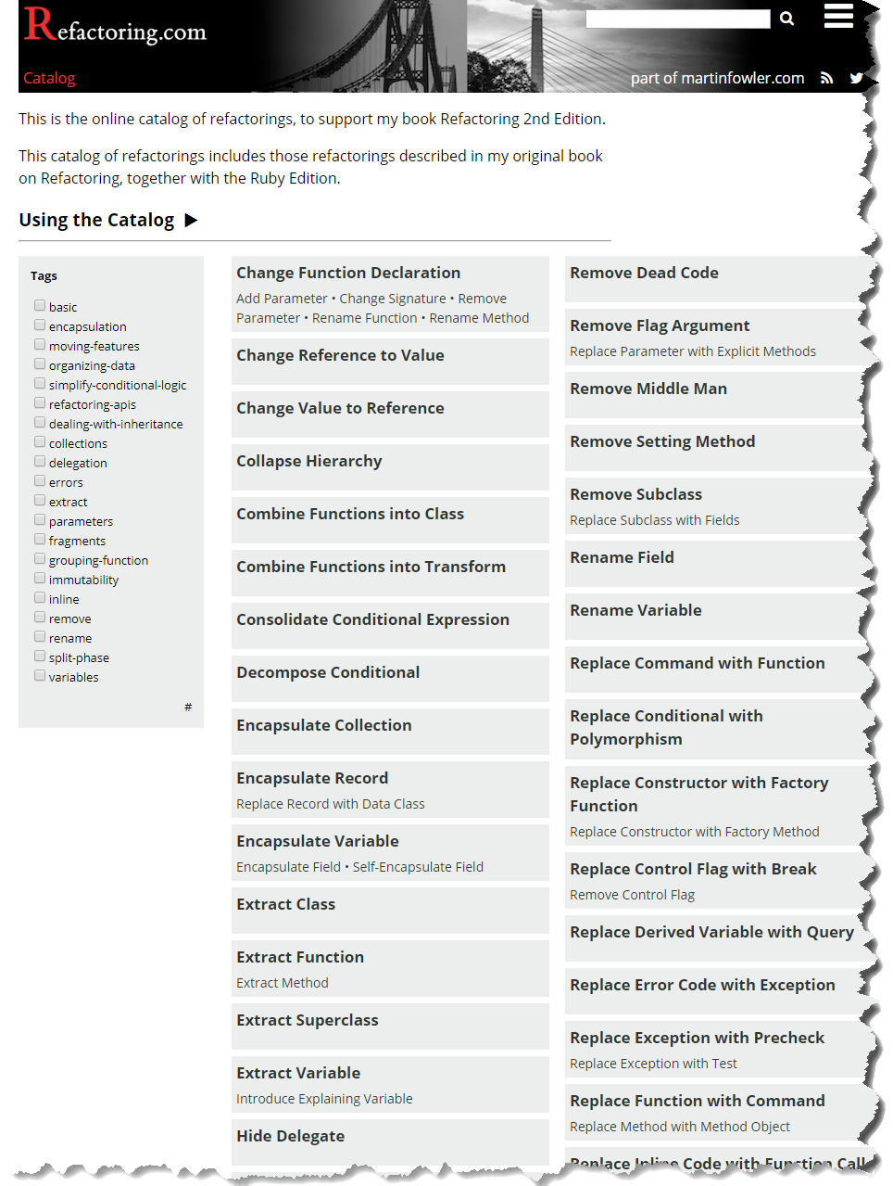

Slide 13
Task Refactoring Catalog
Enable Task
Promote Candidate to Task
Decompose Project
Promote to Project
Delegate and Await
Pull from Calendar
Delegate Task
Push to Calendar
Demote Project to Task
Rename to Actionable
Demote to Backlog
Remove Low-Value Task
Demote to Candidate
Split Task
Extract Project from Goal

Slide 14
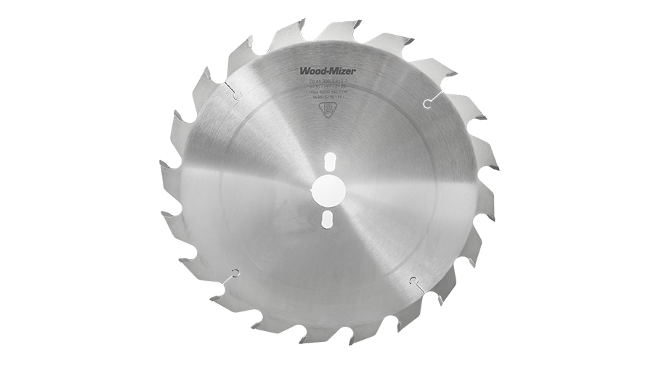

Slide 15


Slide 16



Slide 17
Q & A
Q & A

Slide 19
Task Refactoring
Maximizing Your Personal Throughput
by Sharpening Your “To Do” List
Eric Lynn
DeltaPoint Solutions
@deltapoint

